Slide 1
Detecting Cracks in Concrete Structures Using Adaptive Thresholding for Image Segmentation
Caleb Yearsley
CS 6680
Final Project

Slide 2
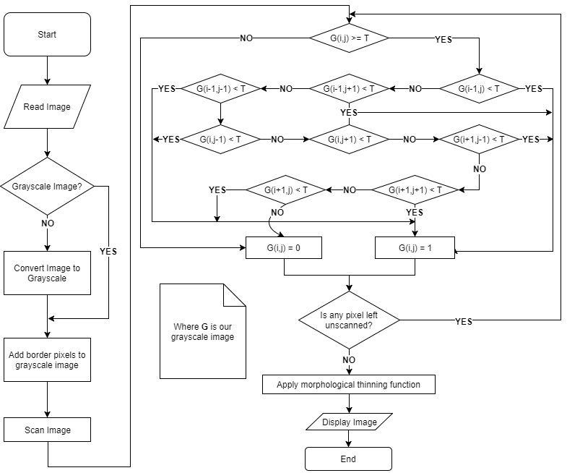
The Proposed Workflow
The proposed method uses a 3x3 mask.
Authors state that this method reduces the amount of noise.

Slide 3
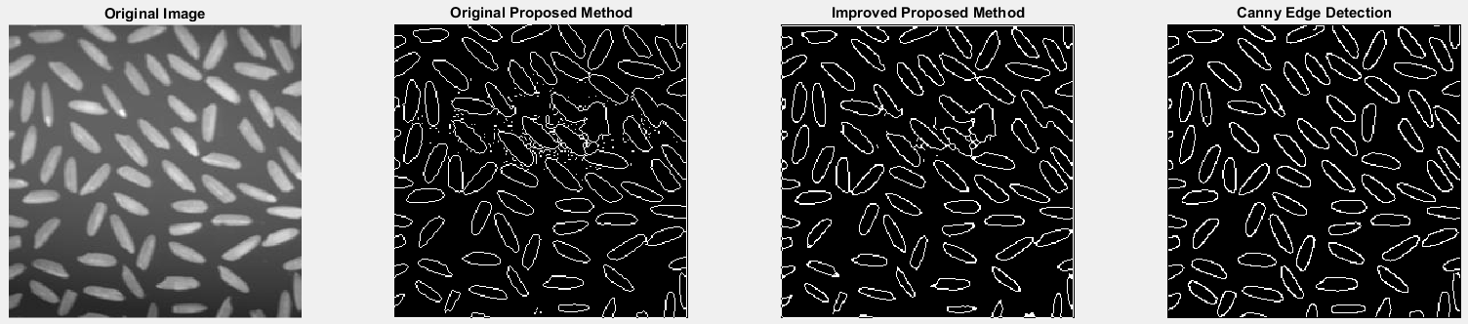
Generic Method Comparison

Slide 4
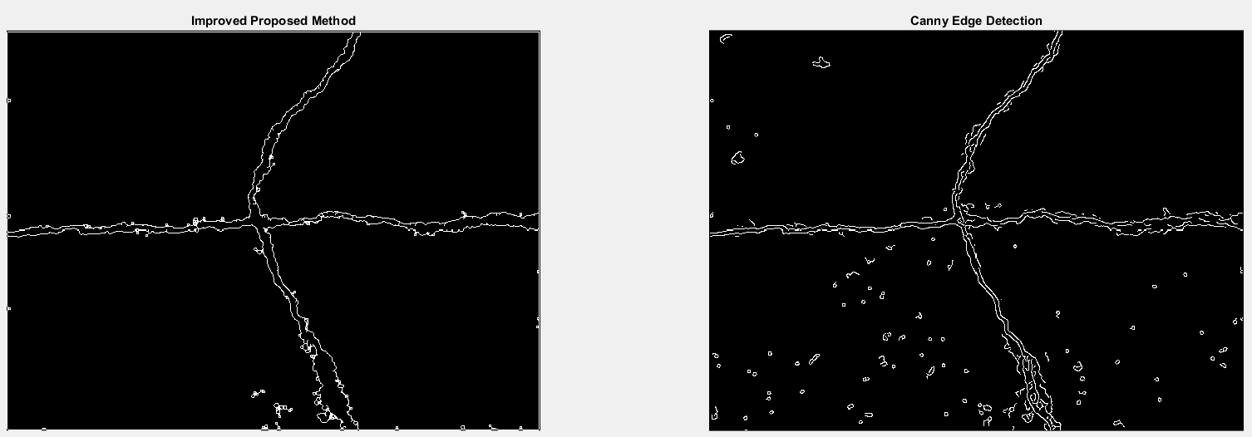
Generic Method Comparison
Modified thresholds until entire crack was visible

